Slide 1
Title: CNN, RNN, and LSTM – Deep Learning Architectures Subtitle: Relevance, Use Cases, and Modern Alternatives (2025)
Mahipal Singh

Slide 2
Overview
CNN: Convolutional Neural Network (for images)
RNN: Recurrent Neural Network (for sequences)
LSTM: Long Short-Term Memory (fixes RNN issues)
Key Question: Are they still relevant in the Transformer era?

Slide 3
CNN – Convolution Neural Network
Designed for grid-like data, especially images
Uses convolution layers to detect local features
Translation invariance: CNNs can recognize objects in an image regardless of their location, size, or orientation, making them well-suited to object recognition tasks.
Requires fewer parameters than fully connected layers
Transfer learning: CNNs can leverage pre-trained models, reducing the amount of data and computational resources required to train a new model.

Slide 4
CNN – Use Cases
Image Classification (e.g. Cats vs Dogs, digit classification etc.)
Object Detection (YOLO, Faster R-CNN)
Medical Imaging (X-rays, MRIs)
Facial Recognition

Slide 5
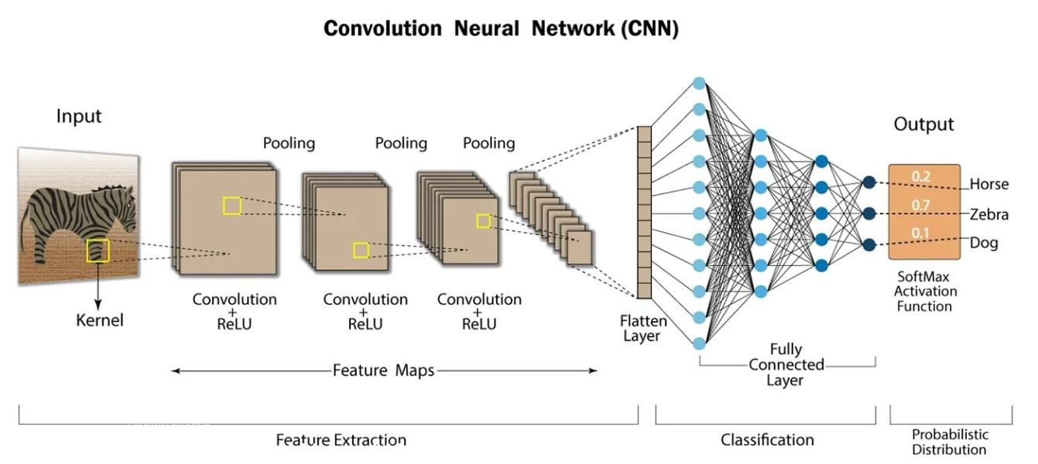
Architecture
CNN – Architecture (Visual)
Include Diagram
Input → Conv → ReLU → Pool → FC → Output [You can use any CNN architecture image like VGG16 or simple LeNet]

Slide 6
CNN – Limitations
Computational cost: Training a deep CNN can be computationally expensive, requiring significant amounts of data and computational resources.
Overfitting: Deep CNNs are prone to overfitting, especially when trained on small datasets, where the model may memorize the training data rather than generalize to new, unseen data.
Lack of interpretability: CNNs are considered to be a “black box” model, making it difficult to understand why a particular prediction was made.
Limited to grid-like structures: CNNs are limited to grid-like structures and cannot handle irregular shapes or non-grid-like data structures.

Slide 7
RNN – Concept
RNNs handle sequential data
Each output depends on previous input (memory)
Common in early NLP, speech recognition
Unlike regular neural networks (which treat each input independently), RNNs remember context, which is crucial for language, time-series, and any sequential tasks.

Slide 8
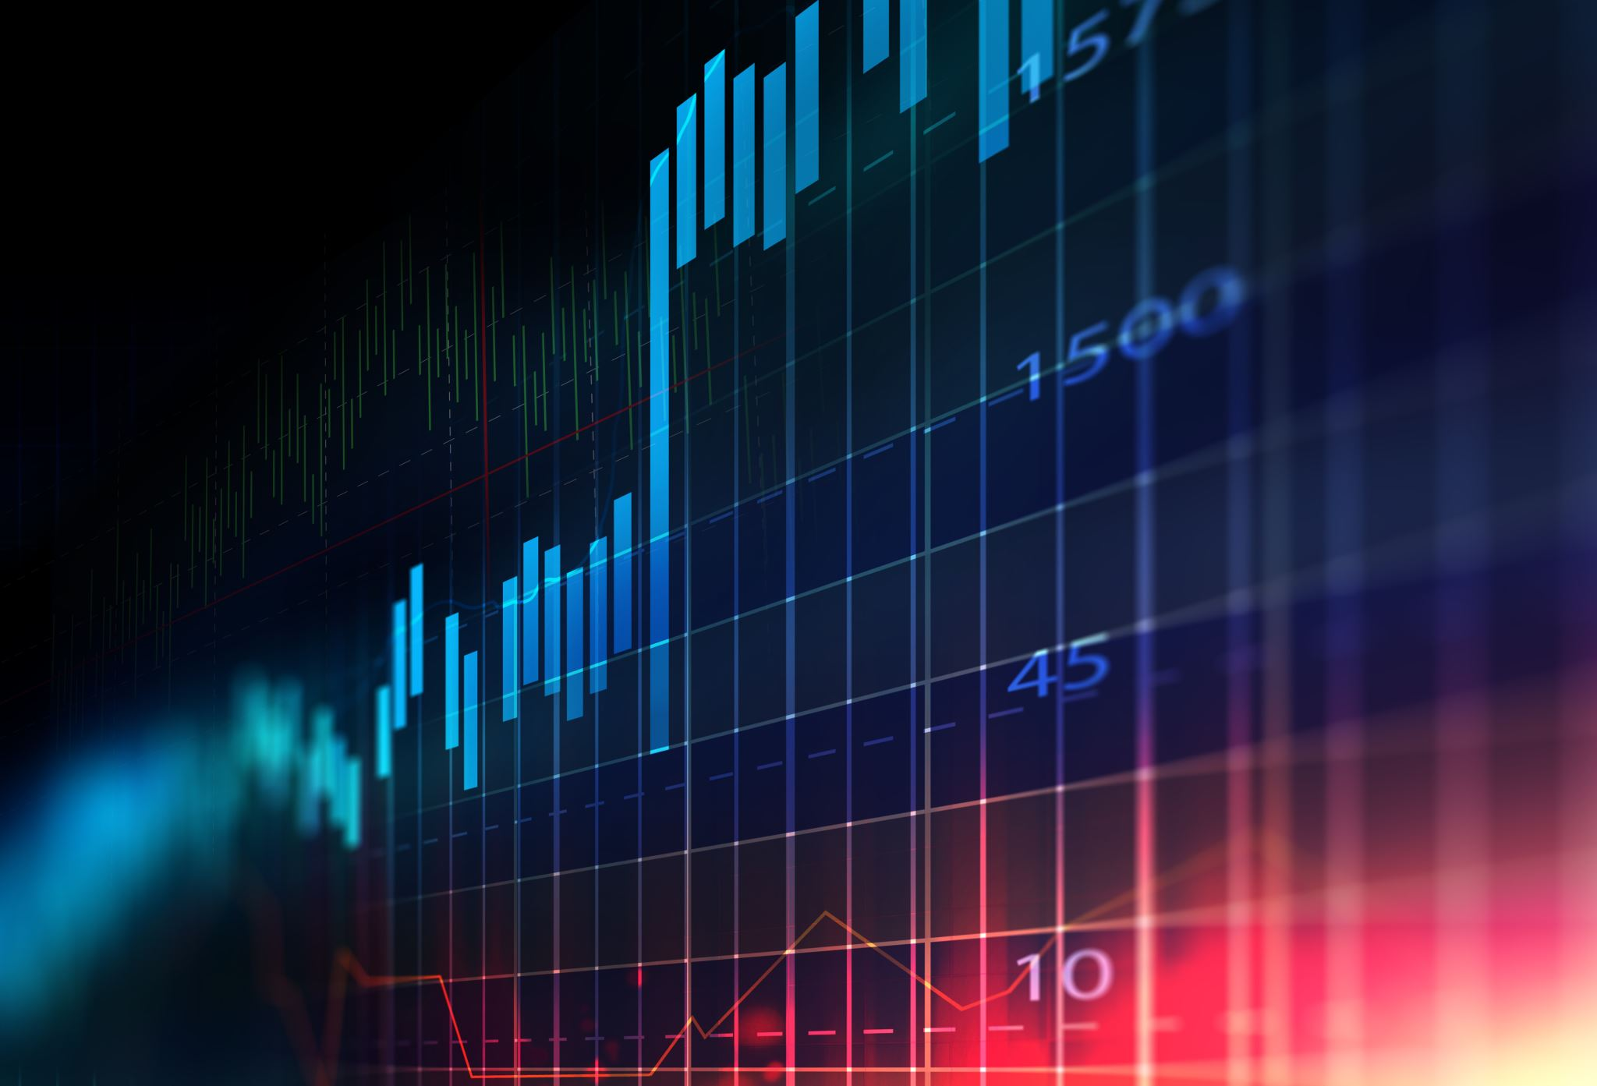
RNN – Use Cases
Stock Price Prediction
Input: Time-series stock data
Output: Future price prediction
Example: Predicting tomorrow’s stock close price based on past 10 days
Speech Recognition
Input: Audio waveform over time
Output: Transcribed text
Example: Converting a voice command into "Play music“
Text Generation
Input: Previous words in a sentence
Output: Next word prediction
Example: Autocomplete or chatbot replies

Slide 9
RNN – Limitations
Vanishing gradient problem for long sequences
Hard to remember distant dependencies
Difficult to parallelize → slower training

Slide 10
LSTM – What It Fixes
LSTM = Long Short-Term Memory (1997)
Has memory cells, forget gates
Remembers long-term dependencies
Solves vanishing gradient issue of RNNs

Slide 11
LSTM – Use Cases
Machine translation (before Transformers)
Speech recognition (Google Voice)
Music generation (sequences)
Chatbot memory

Slide 12
Limitations of LSTM
Still slow to train
Requires sequential processing
Struggles with really long sequences
Mostly replaced by Transformers since 2017

Slide 13
Key Differences from Basic RNN
Feature | RNN | LSTM
Memory | Short-term | Long + short-term
Vanishing Gradient | Yes | Solved
Best For | Short sequences | Long sequences
Training Stability | Low | High

Slide 14
Are CNN/RNN/LSTM Still Useful in 2025?
Model | Still Useful? | Notes
CNN | Yes | Best for image, video, medical, still active
RNN | No | Replaced by LSTM and Transformers
LSTM | Niche | Used in small devices or legacy systems

Slide 15
Transformer vs LSTM
Feature | LSTM | Transformer
Parallelizable | NO | YES
Handles Long-Range | Limited | Yes
NLP Accuracy | Good | Excellent
Use Today | Shrinking | Standard for GenAI

Slide 16
Where They Are Used (2025)
Model | Use Case | Example
CNN | Vision | Self-driving, diagnostics
LSTM | On-device NLP | Smartwatches, IoT
Transformer | GenAI, RAG | ChatGPT, Claude, Gemini

Slide 17
Summary
CNNs → Still key for vision
RNNs → Mostly obsolete
LSTM → Legacy/edge use, but largely replaced
Transformers → Powerhouse behind GenAI

Slide 18
Recommendation
Learn CNNs if you're going into medical imaging, computer vision
Avoid RNNs unless for academic/legacy work
LSTM might be needed in low-resource NLP
Focus on Transformers, LoRA, RAG for modern AI roles

